Slide 1

Introduction to Java Programming
Brian Craig

Slide 2
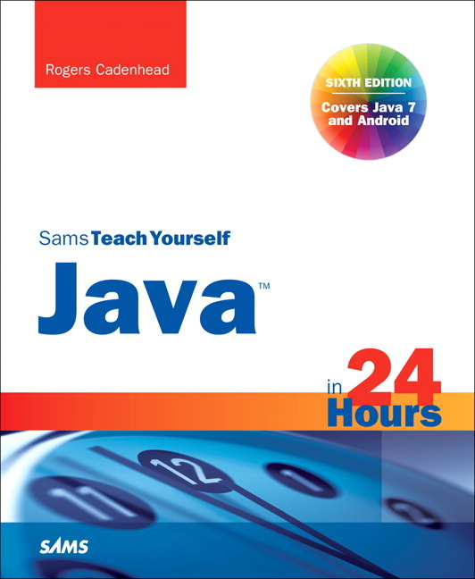
Text
Sams Teach Yourself Java in 24 Hours
6th Edition
Rogers Cadenhead

Slide 3
Hour 1
Becoming a Programmer

Slide 4
What is a Programming Language
Programming languages work like spoken language
Gives humans a way to tell a computer what to do

Slide 5
Choosing a Language
Languages
BASIC
Visual Basic
C#
C++
Java
100’s of others
Why Java?
Used on internet & mobile phones
Organized language
Invented by James Gosling
Didn’t like C++
3 billion devices run Java
Learning one language makes it easy to learn others

Slide 6
Telling the Computer What to Do
Computer Program = Software
Everything a computer does is done by software
Examples:
Windows 8, Minecraft, Internet Explorer, iTunes, viruses
Programs made up of list of commands to be performed in a specific order
Command = Statement
Example:
Clean your room
Mow the lawn
Play videogames
Go to bed

Slide 7
Telling the Computer What to Do
Go to: www.calormen.com/applesoft
Enter the following commands:
10 PRINT “Shall we play a game?”
20 INPUT A$

Slide 8
How Programs Work
Interpreted Languages
Compiled Languages

Slide 9
When Programs Don’t Work
Syntax Errors
Broke the rules of the language
Computer doesn’t understand
Compile-time error
Logic Errors
Obeys the rules of the language
Computer doesn’t do what you want or expect
Run-time error

Slide 10
Choosing a Java Programming Tool
Java Development Kit (JDK)
NetBeans Integrated Development Environment (IDE)

Slide 11
Installing a Java Development Tool
Use the provided CD
Install JDK on your PC
Try 64-bit version first
If it does not work, use x86 version
Install Netbeans on you PC

Slide 12
Summary
Concept of Programming – Giving instructions
Installed JDK and Netbeans

Slide 13
Hour 2
Writing Your First Program

Slide 14
What You Need To Write Programs
Netbeans IDE
Source code (Text) editor
Simple text files – can open in Notepad
Color highlights

Slide 15
Creating a Project for This Class
We need to create a project for this class
All our programs will go into this project
Open Netbeans
Select File > New Project
Category: Java
Project: Java Application
Click Next
Project Name: Java24
Deselect “Create Main Class”
Click Finish

Slide 16
Beginning the “Hello World” Program
Our first program will simply print “Hello World” on the screen
Add a new program to the Java24 Project
File > New File
Project: Java24
Categories: Java
File Types: Empty Java File
Click Next
Name and Location
Name: HelloWorld
Package: <blank>
Note created file name (HelloWorld.java)
Click Finish

Slide 17
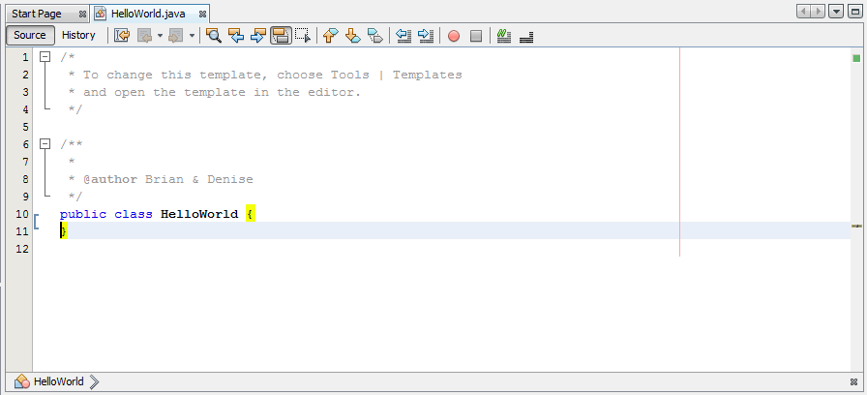
The class Statement
Gives your class (program) a name: HelloWorld
In Java class name always matches the file name

Slide 18
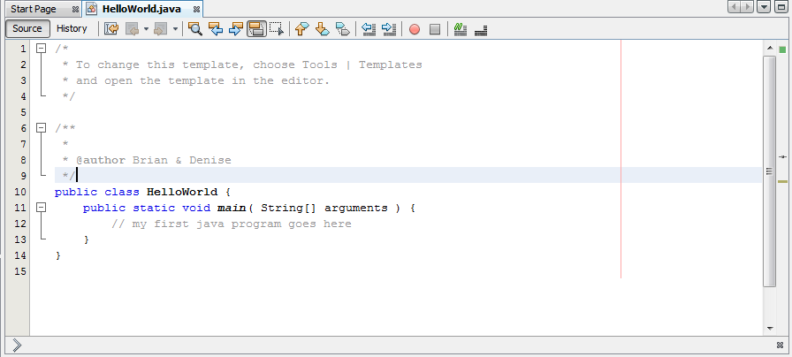
What the main Statement Does
The main part of the program begins here
Programs always start with main
Exceptions: applets and servlets
The main part of the program begins here
Programs always start with main

Slide 19
Those Squiggly Bracket Marks
The main part of the program begins here
Programs always start with main
Exceptions: applets and servlets
{ and } enclose blocks
Class Block
Main Function block
Blocks inside of blocks - Nesting

Slide 20
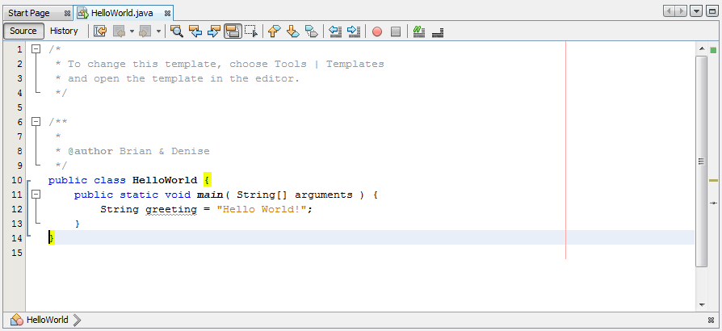
Storing Information in a Variable
Variable: storage place in computer memory:
Numbers, characters, text, true/false
Can change
Type of variable:
String
Content of variable:
Hello World
Statement ends with ;

Slide 21
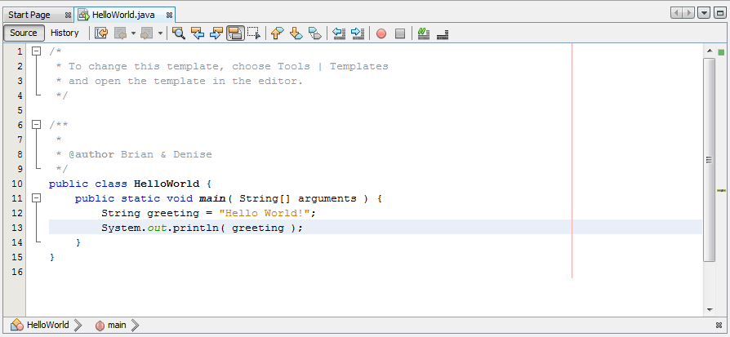
Displaying the Contents of a Variable
Print the greeting to the console
Save the file: File > Save

Slide 22
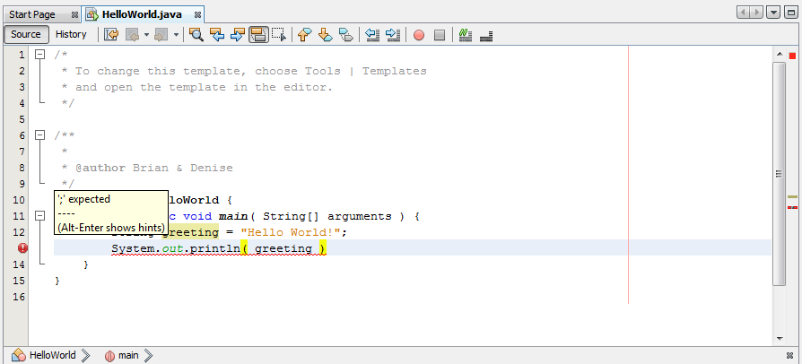
Fixing Errors
Error due to missing semicolon

Slide 23
Running a Java Program
Run > Run Project, or
Run button (green arrow), or
F6
Output displays in Output pane

Slide 24
Summary
Wrote our first program
Compile program
Run program

Slide 25
Homework
Read Chapter 3
Visit the websites mentioned in the text

Slide 26
Hour 4
Understanding How Java Programs Work

Slide 27
Review
What are the two types of programming languages?
Interpreted
Compiled
When you compile a Java program, what are you doing?
Converting it into a form the computer can understand
What is a variable?
A place to store information in a program
What is the process of fixing errors called?
Debugging

Slide 28
Review
Keywords
class
public
static
void
Special characters
( )
{ }
[ ]
Types
String
API Calls
System.out.println()

Slide 29
Two Types of Java Programs
Applications
Programs that run on your computer
Applets
Programs that run on a web page

Slide 30
Creating an Application
HelloWorld was our first application
New application: Root
Will compute the square root of a number
File > New File…
Category: Java
Type: Empty Java File
Next
Class Name: Root

Slide 31
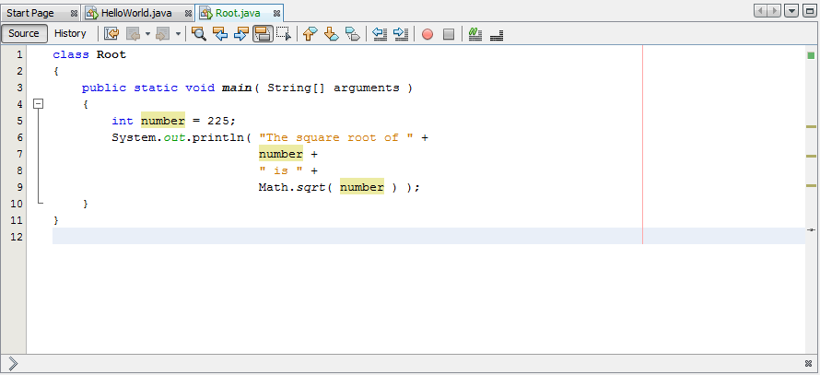
Creating an Application
Initialized to 225
Type int (integer) = whole numbers
Variable number

Slide 32
Creating an Application
Normal print command
Concatenation
Prints contents of number
Compute square root of number AND print it

Slide 33
Setting up Java Path
Set up Java so that it can be run from the command line
Add java to your path
Open Windows Explorer
Go to
C:\Program Files\Java\jdk1.7.0_21\bin, or
C:\Program Files(x86)Java\jdk1.7.0_21\bin
Right-Click on “Computer” -> Select Properties
Click Advanced System Settings
Click Environment Variables
Under User Variables, Click New…
Variable Name: PATH
Variable Value: C:\Program Files\Java\jdk1.7.0_21\bin;%PATH%

Slide 34
Run Java From the Command Line
Open command tool:
Windows 7: Start > Run… > Type “cmd”
Windows 8: Start Screen > All Apps > Windows System > Command Prompt
Type:
cd c:\Users\XXX\Documents\NetBeansProjects\Examples\build\classes
java HelloWorld
This is what Netbeans is doing when we hit run
We can add arguments
java TextDisplayer readme.txt /p “Page Title”

Slide 35
Sending Arguments to Applications
New application: BlankFiller
Will use command line arguments to fill in the blanks in a sentence
File > New File…
Category: Java
Type: Empty Java File
Next
Class Name: BlankFiller

Slide 36
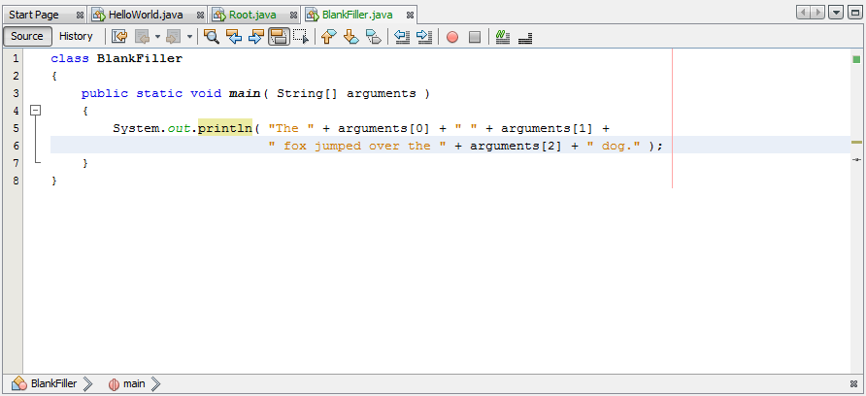
Sending Arguments to Applications
Array: 0 to N of the same type of thing
Arrays always start from 0 – i.e. 0 is the first item in array
Next arg
Next arg

Slide 37
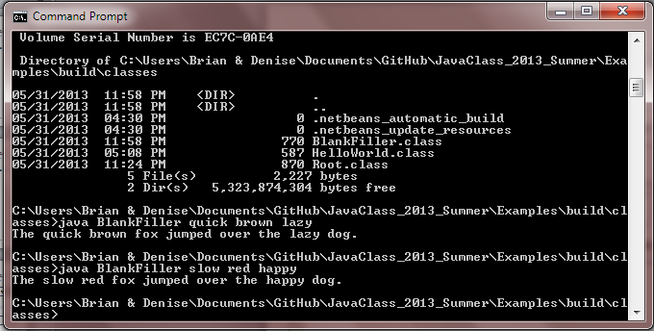
Sending Arguments to Applications
Run BlankFiller from command line
cd to path, java BlankFiller crazy red happy
Run from Netbeans
Run > Set Project Configuration > Customize…
Main Class: BlankFiller, Arguments: quick brown lazy (choose 3 adjectives) OK
Run

Slide 38
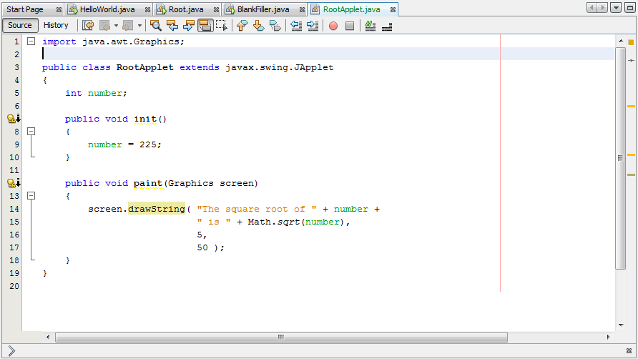
Creating an Applet
extends – inheritance – gets properties of JApplet
Member of class Root Applet
init() – inherited from JApplet – JApplet always calls this on startup
paint() – inherited from JApplet – JApplet calls this every time the screen is painted

Slide 39
Creating an Applet
Graphics screen – tells paint where to draw
drawString – draws a sting on the screen
X position
Y position

Slide 40
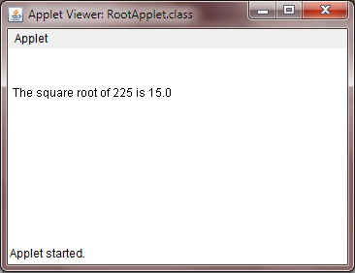
Creating an Applet
0
5
X Position
0
Y Position
50

Slide 41

Hint: Changing a String to an int
You can’t to math on a String
You need to change the String to an int
Integer.decode() will do the trick

Slide 42
GitHub
Go to http://github.com
Create an account (free)
Create a user name
Enter your email (ask if you can use your parents)
Create a password you can remember
Click “Sign up for free”
Setup GitHub
Click on “Set Up Git”
Click on “Download Github for Windows”
In the download popup, click “Run”
In the security warning popup, click “Install” and wait for the download to complete
GitHub tool launches automatically
Run the GitHub windows tool
Sign in using your new username and password
On the configure page, enter your first and last name and email address
In Internet Explorer, go to https://github.com/bcraig108/JavaClass_2013_Summer
Click Fork
Click Clone in Windows
You can view these slides, and examples
You can upload your homework
I will post homework solutions

Slide 43
Summary
Created Java Application that computes square roots
Created Java Application that uses arguments
Created Java Applet

Slide 44
Questions

Slide 45
Homework
Create a New Project: “Homework_yourname” in C:\Users\<UserName>\Documents\GitHub\JavaClass_2013_Summer
In the Homework_yourname project, using the Root application as a guide, create a NewRoot application that can display the square root of 625
In the Homework_yourname project, using the Root application as a guide, create an ArgRoot application that can display the square root of the number provided as an argument
Upload the new project to GitHub (sync)

Slide 46
Hour 5
Storing and Changing Information in a Program

Slide 47
Review
What are the two types of java programs?
Applications
Applets
How do you run java applications?
Command line: java ClassName arga argb argc
Netbeans: Run File
How do you run java applets?
Web Browser
Applet viewer

Slide 48
Review
Keywords
class
extends
import
public
static
void
Special characters
( )
{ }
[ ]
Operators
+
=
Types
String
Graphics
int
API Calls
Graphics.drawString()
Integer.decode()
Math.sqrt()
System.out.println()

Slide 49
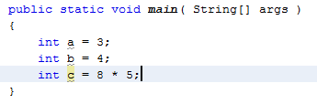
Statements and Expressions
Programs are sets of instructions telling a computer what to do
Each instruction is called a statement
Curly braces group statements together into blocks or block statements
Statements with mathematical calculations are called expressions

Slide 50

Assigning Variable Types
Variables are the way a program remembers something
Variable statements contain
The type of the variable: int, float, String (required)
The name of the variable (required)
The value of the information (optional)
Type
Value
Name

Slide 51
Variable Types
Integer and Floating-Point Numbers
int: any integer from -2.14 billion to +2.14 billion
float: any decimal number up to 38 digits (1 followed by 37 0’s)
Characters and Strings
char: a single letter, number for other character – anything you can type
Enclosed in single quotes
String: a group or string of characters (String is always capitalized because it is really a class)
Enclosed in double quotes

Slide 52

Other Variable Types
byte: integers from -128 to 127
short: integers from -32768 to 32767
long: integers from -9.22 quintillion to 9.22 quintillion
Can use underscores in numbers for readability
double: any decimal number up to 300 digits
boolean: true or false

Slide 53
Naming Your Variables
Variable names can begin with a letter, underscore (_) or dollar sign ($)
The rest of the name can contain any letters or numbers
Variable names are case-sensitive:
GAMEOVER, GameOver, and gameOver are not the same
No spaces in the name
Usually start with a lower-case letter
Usually use camelCase

Slide 54



Storing Information in Variables
You can store a value in a variable when you create it
You can set one variable to the value of another of the same type
Some variables are constants, meaning their values cannot change
Constants are usually all capitals to make them easier to see

Slide 55

Operators
Addition
Subtraction
Division
Modulus (Remainder)
Multiplication

Slide 56
Operators
Increment (add 1)
Decrement (subtract 1)

Slide 57

Operator Precedence
Order of operations
Incrementing and decrementing
Multiplication, division, and modulus
Addition and subtraction
Comparisons
Assignments
1
2
5
3
4

Slide 58
Summary
We learned about variables and expressions
Variables include
Numbers
Booleans
Strings
Characters

Slide 59
Questions

Slide 60

Homework
Write a class called PlanetWeight that works as follows:
When you type: “java PlanetWeight 100”
Your program will print:
Your weight on Mercury is 0.378 times your weight on earth
Your weight on the Moon is 0.166 times your weight on earth
Your weight on Jupiter is 2.364 times your weight on earth

Slide 61
Hour 6
Using Strings To Communicate

Slide 62
Review
What is a statement?
A single command to the computer
What is a block?
A group of statements enclosed in curly braces
What is a variable?
A place to store information in memory
What are the parts of a variable statement?
Type, name and optional initial value
What is a constant?
A variable that cannot change in value
What is an expression?
A mathematical operation

Slide 63
Review
Keywords
class
extends
final
import
public
static
void
Special characters
( )
{ }
[ ]
Operators
=
+
-
*
/
%
++
--
Types
boolean
byte
char
double
float
Graphics
int
long
short
String
API Calls
Graphics.drawString()
Integer.decode()
Math.sqrt()
System.out.println()

Slide 64
Storing Text in Strings
Basic element of string is character, or char
A single letter, number, punctuation mark or special character
Initial value is optional, but recommended
Value must be surrounded by single quotes
A String is a collection of characters
Value must be surrounded by double quotes
Name of the type String is capitalized
String is a class – classes are always capitalized

Slide 65

Displaying Strings in Programs
System.out.println() – prints a line with a newline
System.out.print() – prints text with no new line

Slide 66

Using Special Characters in Strings
What if you want to display double quotes?
Use an escape sequence “\””
Newline sequence “\n”
Other escape sequences (see page 67)
Single quote \’
Double quote \”
Backslash \\
Tab \t
Backspace \b
Carriage Return \n
Form Feed \f

Slide 67

Pasting Strings Together
Concatenation: + operator

Slide 68


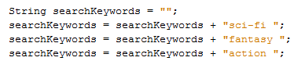
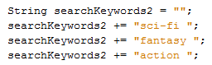
Using Other Variables With Strings
Operator + can be used to add other variables to strings
You can add String to Strings
This way: Or this way:

Slide 69
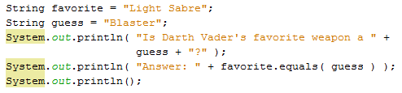

Comparing Two Strings
You can compare 2 string to see if they are the same

Slide 70

Determining the Length of a String
You can find out how long a string is with the length() method

Slide 71


Changing a String’s Case
You can use toUpperCase() and toLowerCase() to change the case of the characters in a string

Slide 72
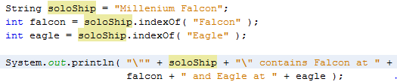
Looking for a String
You can find string within a string
If the string is found, the index is returned
If the string is not found, the index is -1

Slide 73
Summary
Learned Strings

Slide 74
Questions

Slide 75
Homework
Write a game program called “SecretWord” where the user tries to guess your secret word
When the user guesses the right word, it prints out:
Match = true
When the user guesses the wrong word, it prints out:
Match = false
If the secret word is “boot” and the user guesses “BOOT” or “Boot” or “boot” or “BoOt” (any combination of cases) the program should count that as a match
To run your program, at the command line, type:
java SecretWord <your guess here>

Slide 76
Hour 7
Using Conditional Tests to Make Decisions

Slide 77
Review
Last time we learned about Strings and what you can do with them
Print lines
Special characters
Concatenate Strings
Compare Strings
Find the length of Strings
Change the case of Strings
Find Stings within Strings

Slide 78
Review
Keywords
class
extends
final
import
public
static
void
Special characters
( )
{ }
[ ]
Operators
=
+
-
*
/
%
++
--
+=
Types
boolean
byte
char
double
float
Graphics
int
long
short
String
API Calls
Double.parseDouble()
Graphics.drawString()
Integer.parseInt()
Math.sqrt()
String.equals()
String.indexOf()
String.length()
String.toLowerCase()
String.toUpperCase()
System.out.print()
System.out.println()

Slide 79
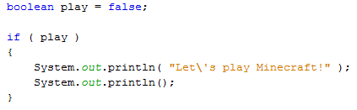
if Statements
if statements check if a condition is true
When the condition is true, the program will do whatever is inside the if statement block
When the condition is not true, the program will not execute the commands inside the block

Slide 80
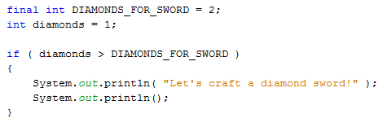
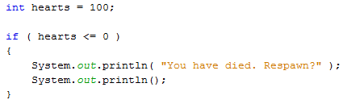
Less Than and Greater Than Comparisons
Less-than (<) and Greater-Than (>) operators can be used inside an if conditional
Less-than-or-equal-to (<=) and Greater-than-or-equal-to (>=) operators can also be used inside an if conditional

Slide 81
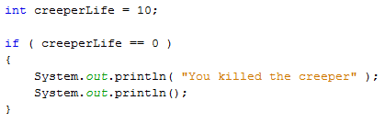
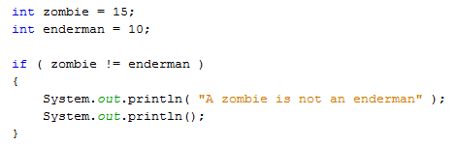
Equal and Not Equal Comparisons
Equal (==) and not-equal (!=) operators can also be used inside an if conditional

Slide 82
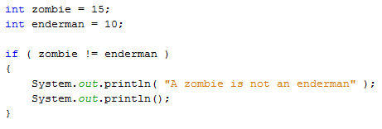
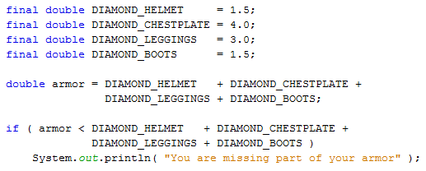
Organizing a Program with Block Statements
Curly braces allow multiple lines to be associated with the if statement
Without curly braces, only one line will be associated with the if statement

Slide 83
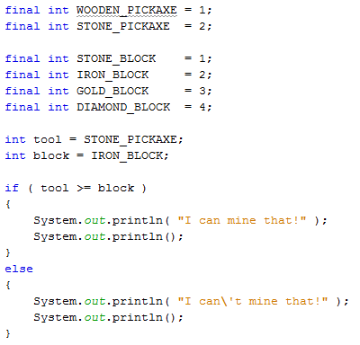
if-else Statements
If you want to do one thing if the condition is met and a different thing if the condition is not met, use an “else” statement

Slide 84
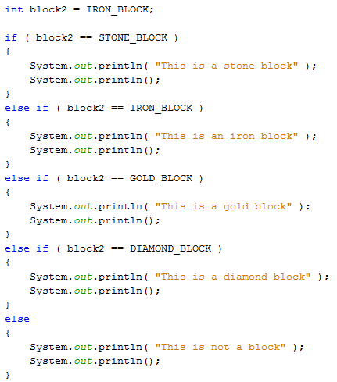
else if Statements
If you want more than 2 alternatives, the “else if” statement can be used:

Slide 85
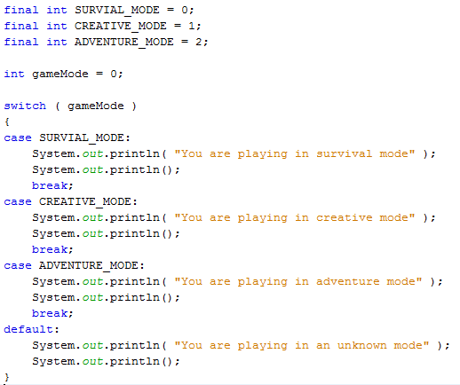
switch Statements
Instead of a long series of “if…else if…else” statements, you can use a “switch…case” statement:
default is selected if no other case matches

Slide 86
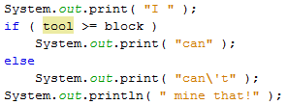

The Conditional Operator
A very condensed way of writing an “if…else” statement like this:
Is to write it like this:
This is called a conditional operator or a ternary operator

Slide 87
Watch the Clock
See the example on pages 88-89, which puts all this together

Slide 88
Summary
We learned about conditional statements
if
else
else if
switch/case/default

Slide 89
Questions

Slide 90
Homework
Read the pages 87-91 (Watch the Clock)
Copy the program and run it
Make sure you understand how each section works
Change your SecretWord program so that:
Instead of printing “Match=true” or “Match=false”
Make it print:
“You guessed the secret word!”, or
“Sorry, try again!”

Slide 91
Hour 8
Repeating an Action with Loops

Slide 92
Review
Last time we learned about conditionals and how they work
“if” statement
“else” statement
“else if” statement
“switch statements

Slide 93
Review
Keywords
case
class
default
else
extends
final
if
import
public
static
switch
void
Special characters
( )
{ }
[ ]
Operators
= - assignment
+ - add/concatenate
- - subtract
* - multiply
/ - divide
% - modulus
++ - increment
-- - decrement
+= - increment assign
? : - conditional/tenary
Types
boolean
byte
char
double
float
Graphics
int
long
short
String
API Calls
Double.parseDouble()
Graphics.drawString()
Integer.parseInt()
Math.sqrt()
String.equals()
String.indexOf()
String.length()
String.toLowerCase()
String.toUpperCase()
System.out.print()
System.out.println()

Slide 94

“for” Loops
“for” loops repeat a block of code a fixed number of times
The variable “index” is used to count the number of times through the loop
starts the index at 0 the first time through
stops the loop before the index reaches 10
adds one to the index each time through the loop

Slide 95

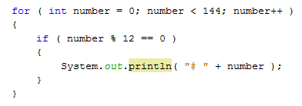
“for” Loops
“for” loops can consist of ONE line without curly braces
Loops can contain “if” statements
In this example, the contents of the if block is executed depending on the value of number, which changes every time through the loop

Slide 96
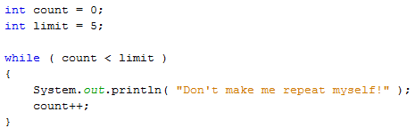
“while” Loops
"while" loops repeat while the condition is true
This loop will stop when count equals 5
If count is not incremented the loop will repeat FOREVER!

Slide 97
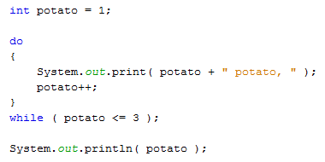
“do-while” Loops
"do-while" loops are similar to "while" loops, but the condition is checked at the end
This guarantees that the contents of the loop will be executed at least once

Slide 98
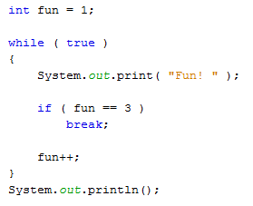
Exiting a Loop
A break statement can be used to exit a loop
This loop will continue until fun is equal to 3, then it will exit immediately

Slide 99
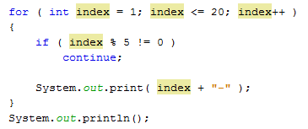
Exiting a Loop
A continue statement can be used to skip part of the code in a loop
This loop will only print when index is divisible by 5

Slide 100
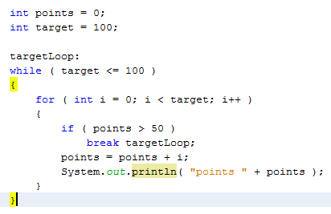
Naming a Loop
Sometimes you need to have a loop inside a loop
You may want to exit both loops as once
You need to use a label for the loop
Loop Label

Slide 101
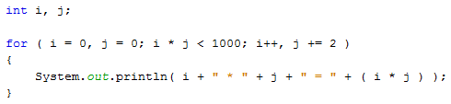
Complex “for” Loops
"for" loops can have more that one index value
There are 2 indexes, i and j
Both are initialized to 0
Both are used in the conditional
Both are incremented each time through the loop

Slide 102
Summary

Slide 103
Questions

Slide 104
Homework
Read the pages 102-104 (Test Your Computer Speed)
Copy the program and run it
Make sure you understand how the loop works
Change your SecretWord program so that:
Instead of using args[0], it uses the following to read the guess from the user:
Scanner readUserInput = new Scanner(System.in);
-- and --
System.out.print( "Enter your guess: " );
String guess = readUserInput.nextLine();
Loop until the user guesses the right answer

Slide 105
Hour 9
Storing Information with Arrays

Slide 106
Review

Slide 107
Review
Keywords
break
case
class
continue
default
do
else
extends
final
if
import
loop
public
static
switch
void
while
Special characters
( )
{ }
[ ]
Operators
= - assignment
+ - add/concatenate
- - subtract
* - multiply
/ - divide
% - modulus
++ - increment
-- - decrement
+= - increment assign
? : - conditional/tenary
Types
boolean
byte
char
double
float
Graphics
int
long
short
String
API Calls
Double.parseDouble()
Graphics.drawString()
Integer.parseInt()
Math.sqrt()
String.equals()
String.indexOf()
String.length()
String.toLowerCase()
String.toUpperCase()
System.out.print()
System.out.println()

Slide 108
Creating Arrays
Arrays are groups of related variables of the same type
All members of an array are addressed with the same name
Square brackets after the type are used to designate arrays

Slide 109
Using Arrays

Slide 110
Multidimensional Arrays

Slide 111
Sorting an Array

Slide 112
Summary

Slide 113
Questions

Slide 114
Homework
Read the pages 113-115 (Counting Characters in Strings)
Copy the program and run it
Make sure you understand how the program works
Change your SecretWord program so that:
Instead of containing just one secret word, change the secret word variable to an array, containing at least 3 words
Randomly select the secret word for the user by selecting a random index into your new array as follows:
int index = (int)Math.round( Math.random() * ( secret.length - 1 ) );
Loop until the user guesses the right answer

